Slide 1


Housing Price Prediction
Sahil Kumar

Slide 2
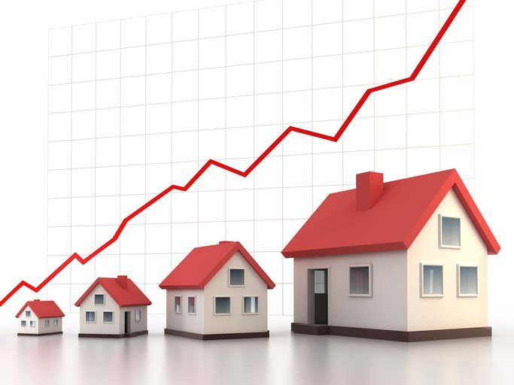
Acknowledgement
I would like to express my heartfelt appreciation to Flip Robo Technologies for providing me with the opportunity to work on this project on housing price prediction using machine learning algorithms. I'd also like to thank Flip Robo Technologies for providing me with the necessary datasets.
I'd like to thank the Data Trained Academy and FlipRobo Technologies teams for their invaluable assistance in providing guidance to work on real-time data projects, which also helped me do a lot of research and gain insights.

Slide 3
Introduction
Houses are one of the necessary needs of every person around the globe and therefore housing and real estate market is one of the markets which is one of the major contributors in the world’s economy. It is a very large market and there are various companies working in the domain.
Data science comes as a very important tool to solve problems in the domain to help the companies increase their overall revenue, profits, improving their marketing strategies and focusing on changing trends in house sales and purchases. Predictive modelling, Market mix modelling, recommendation systems are some of the machine learning techniques used for achieving the business goals for housing companies.

Slide 4
Problem statement
A US-based housing company named Surprise Housing has decided to enter the Australian market. The company uses data analytics to purchase houses at a price below their actual values and flip them at a higher price. For the same purpose, the company has collected a data set from the sale of houses in Australia.
The requirement is to build a model using Machine Learning to predict the actual value of the prospective properties and decide whether to invest in them or not. The primary questions that needed answering were:
Which variables are important to predict the price of variable?
How do these variables describe the price of the house?

Slide 5
Problem statement
The task was to model house prices using the available independent variables. The management will then use this model to understand how the prices vary with the variables. As an outcome, they can manipulate the firm's strategy and focus on areas that will yield high returns. Furthermore, the model will assist management in comprehending the pricing dynamics of a new market.

Slide 6
Domain knowledge
Housing market is a critical driver of economic growth in most countries across the world. Despite the size and complexity of the real estate market, many people believe it is only comprised of brokers and salespeople.
However, millions of people make a living in the real estate industry, not only in sales but also in appraisals, property management, financing, construction, development, counselling, education, and a variety of other fields.
Investors and analysts keep a close eye on housing because the numbers can provide a general sense of economic direction. Moreover, the type of new housing can give clues about how the economy is developing.

Slide 7
Understanding of the problem
The house pricing model relies on a housing demand function and a conventional utility life-cycle model for a typical household. This is a frequent method used in academic studies of housing prices. The goal of the research is to forecast the house's sale price by examining which features are essential and how they contribute to the prediction.
The target variable was the sale price of the house. We were provided with two datasets – a training dataset and a test dataset. The training dataset was used to obtain an understanding on the information provided, conduct exploratory data analysis, understanding what attributes were irrelevant, pre-processing the data, conduct data visualizations, encoding of categorical data, establishing correlations with sale prices of the houses, carrying out principal component analysis and finally, building the prediction model.

Slide 8
Understanding of the problem
A US based housing company – Surprise Housing collected the data from the sale of houses in Australia, as they were expanding to this market. The training and test datasets, both, were provided by FlipRobo Technologies for the purpose of building the machine learning based prediction model, in the hopes of helping out Surprise Housing with a basis for purchasing properties in this new market at appropriate prices, primarily in order the mitigate the risk arising out of internationalization of operations, new market entry and lack of knowledge on key factors playing a definitive role in deciding the prices of houses on the real estate market.

Slide 9
Understanding of the problem
The datasets were provided in CSV formats. The training dataset contained 1168 records across 80 features, plus 1 target variable – the sale price of the house. The test dataset however, contained 292 records of houses on sale, or with the possibility of entering the on-sale market with the same 80 features, wherein the sale price was required to be predicted because of our prediction model.

Slide 10
EDA steps, pre-processing and preparation for model building
Assessed the shape of the dataframe
Studied a concise summary of a DataFrame using df.info( ), listing all the columns, their data types, and the sum of null values in each column
Analyzed the unique values in each column, based on which we dropped “Id” and “Utilities” as they contained all unique values and only one unique value, respectively
Printed the value counts of each unique record from all columns
Created a dataframe to assess the count and percentage of zero values in each column, following which all columns with records containing more than 85% zero values were dropped

Slide 11
EDA steps, pre-processing and preparation for model building
Time variables containing value in terms of years converted into age by subtracting each value from the year in which a house was sold
Dropped the columns containing values in terms of years (except for year in which the house was sold) since the relevant age values had been extracted
Analyzed the skewness in the training dataset before processing, normalization and cleaning of data
The quantum of null values across each independent feature was analyzed, and columns containing mostly null values (over 75%) were dropped as no independent and collective method for filling these values could be ascertained
Null values in the remaining columns were filled using appropriate imputation techniques, i.e., using mean for numerical values and mode for categorical values

Slide 12
EDA steps, pre-processing and preparation for model building
The df.describe( ) method used to return the description of the data in the DataFrame, and findings from the dataset description were documented
Post data visualization and the extraction of relevant insights therein, outliers were checked and removed to a great extent using the percentile method, since both z-score and IQR methods were resulting in massive data losses
Skewness in the features was removed by using the power transformer with the Yeo-Johnson method
The column “KitchenAbvGr” was dropped due to all zero values being present in the column post the steps carried out above, leaving us with 66 columns of data

Slide 13
EDA steps, pre-processing and preparation for model building
The data in categorical columns was encoded using the Ordinal Encoder, and post establishing the relevant correlations, Standard Scaler was applied to scale the data
A principal component analysis was carried out and 50 independent variables were selected covering around 95% of the variance %
Similar pre-processing was carried out on the test dataset for the purpose of predicting the sale price of the houses, after the best prediction model had been built, i.e., using the Random Forest Regression algorithm

Slide 14
Data visualization
The relationship between the features and the target was analyzed through exploratory data analysis and through various data visualizations (univariate, bivariate and multivariate).
The univariate data visualizations involved deriving insights on the distribution and count of various unique records across distinct columns/features in the dataset.
Visualizations for bivariate analysis included understanding the relationships between sale price of a house and the various features provided in the dataset.
Using a pair plot, multivariate analysis was conducted to understand the relationships of various features with each other.

Slide 15
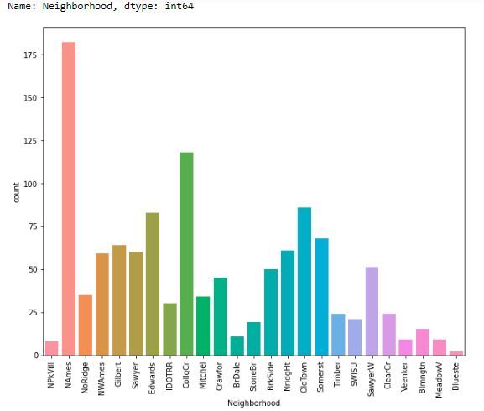
Key visualizations for univariate analysis
North Ames has the highest numbers, followed by College Creek, Old Town and Edwards. Northpark Villa, Briardale,Veenker, Meadow Village and Bluestem have the lowest numbers in houses sold

Slide 16
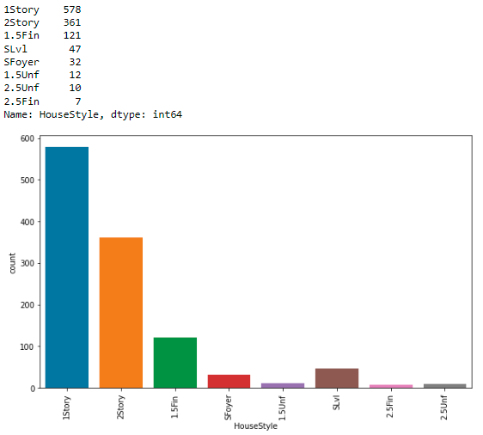
Key visualizations for univariate analysis
One story styled dwelling have the highest numbers, followed by Two story, One and one-half story: 2nd level finished, and SplitLevel. All other styles of dwelling have lower numbers

Slide 17
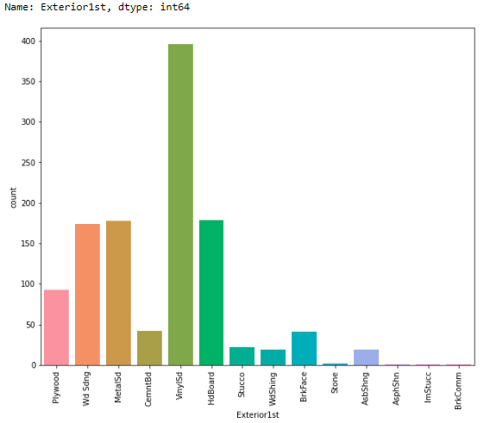
Key visualizations for univariate analysis
In terms of Exterior covering on house, Vinyl Siding is the highest in number, followed by Hard Board, Metal Siding and WoodSiding.

Slide 18
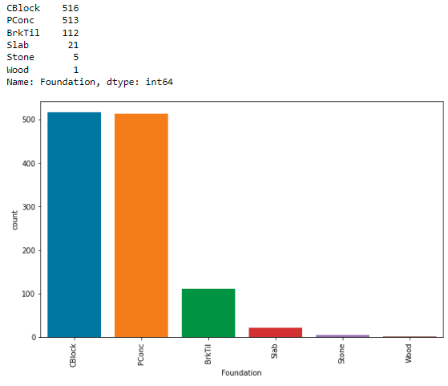
Key visualizations for univariate analysis
Cinder Block and Poured Concrete have almost equal numbers, followed by Brick & Tile type of foundation

Slide 19
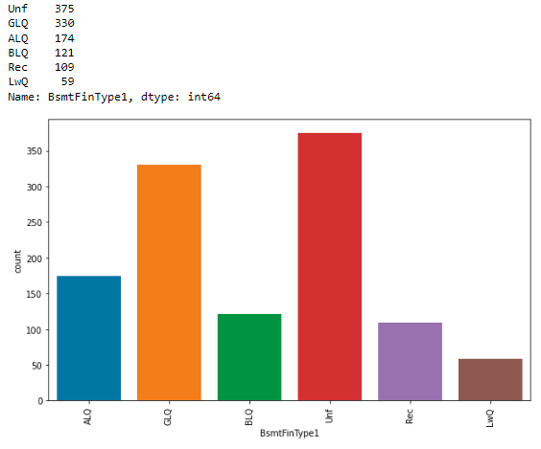
Key visualizations for univariate analysis
The basement finished area of most houses are rated Unfinshed or Good Living Quarters, followed by Average LivingQuarters, Below Average Living Quarters, Average Rec Room, Low Quality, respectively.

Slide 20
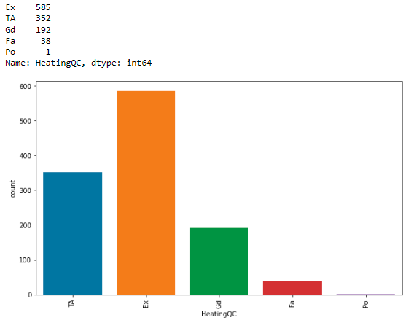
Key visualizations for univariate analysis
In terms of Heating quality and condition, most houses have a rating of Excellent, followed by either typical/average, or Good.

Slide 21
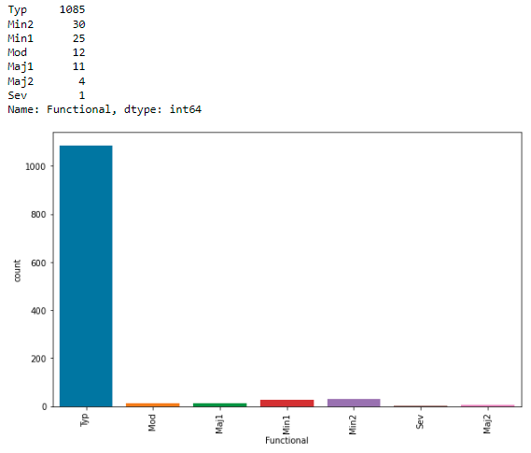
Key visualizations for univariate analysis
In terms of Home functionality, most homes have a Typical Functionality, with few numbers having minor to moderate deductions, 15 homes with major deductions, and 1 with severe damage

Slide 22
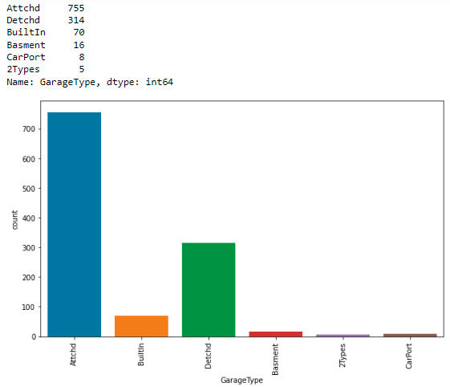
Key visualizations for univariate analysis
Garages in most homes are attached, followed by houses having detached garages

Slide 23
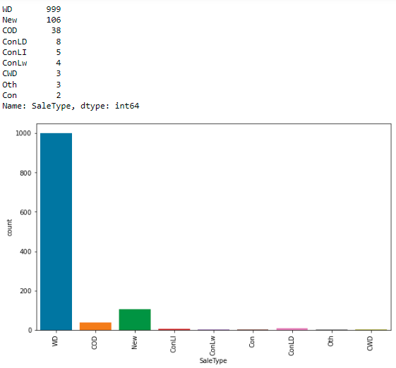
Key visualizations for univariate analysis
The sale of most houses was through a conventional warranty deed, followed by homes that were recently constructed and sold

Slide 24
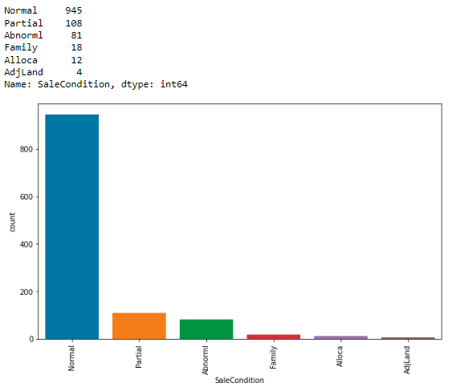
Key visualizations for univariate analysis
Most homes had normal conditions of sale, followed by comparatively low numbers of homes which were not completed when last assessed, and abnormal sales through trade, foreclosure or short sale

Slide 25
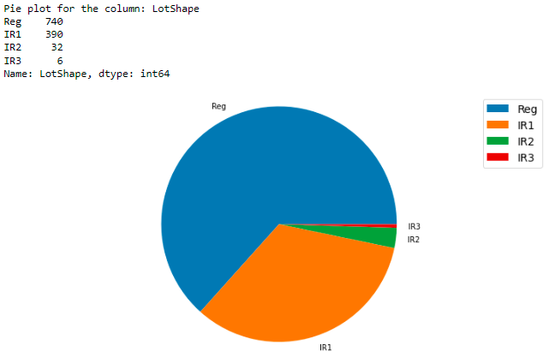
Key visualizations for univariate analysis
Most properties have a regular shape, followed by those that are slightly irregular. There are few properties that are moderately or completely irregular

Slide 26
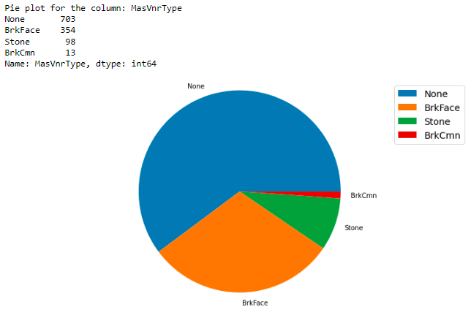
Key visualizations for univariate analysis
Although most homes have no masonry veneers, there are quite a few that have a brick face veneer, followed by stone or brick commons

Slide 27
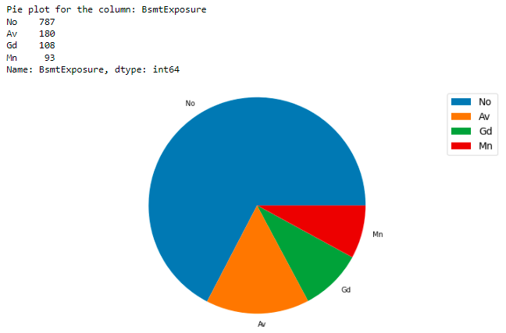
Key visualizations for univariate analysis
Most homes have no exposure to walkout or garden level walls, followed by those with average exposure, good exposure and minimum exposure

Slide 28
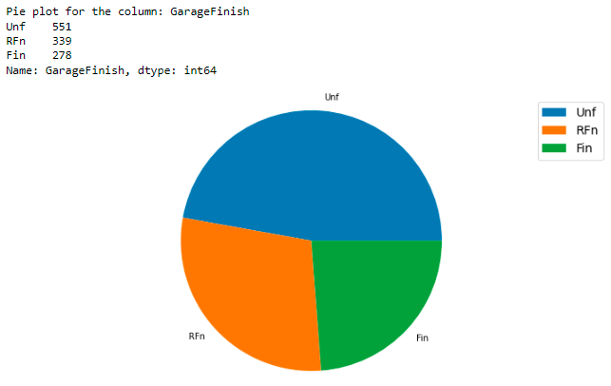
Key visualizations for univariate analysis
The interior finish of garages in most homes is unfinished, followed by those with a rough finish, or are completely finished

Slide 29
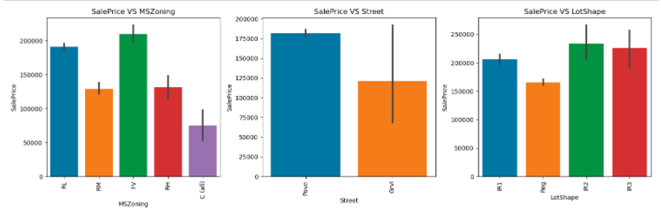
Key visualizations for bivariate analysis

Slide 30
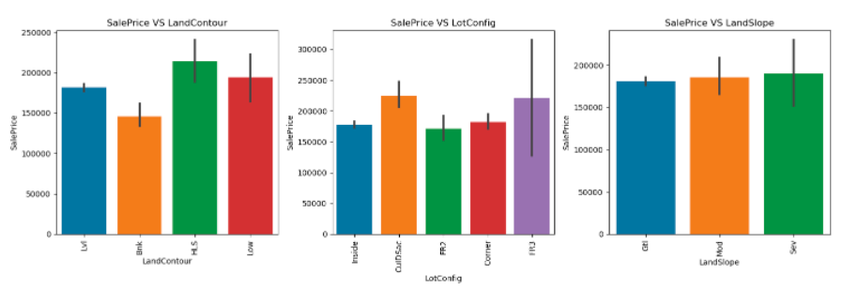
Key visualizations for bivariate analysis

Slide 31
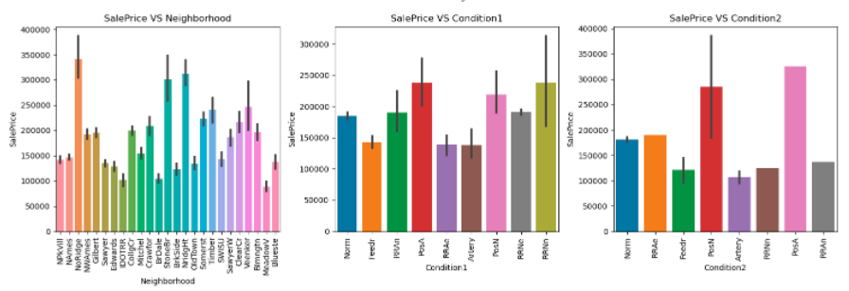
Key visualizations for bivariate analysis

Slide 32
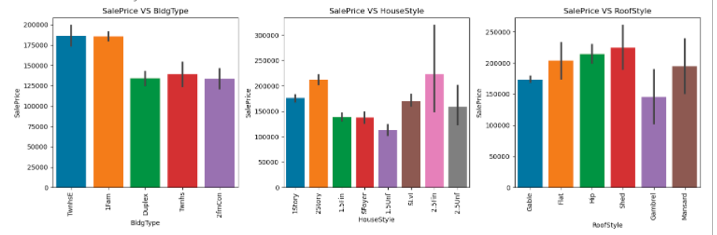
Key visualizations for bivariate analysis

Slide 33
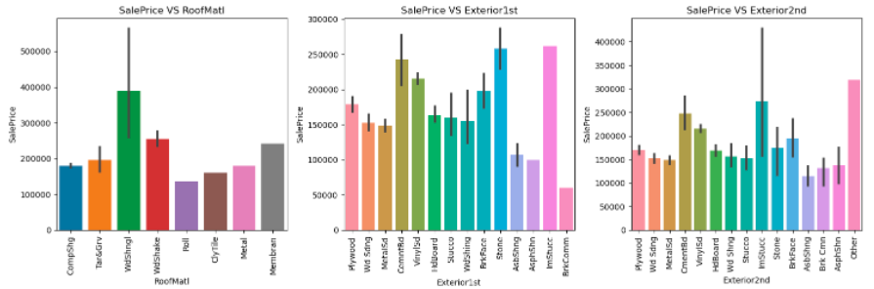
Key visualizations for bivariate analysis

Slide 34
Key visualizations for bivariate analysis
Observations
Floating Village Residential have the highest sale prices, followed by Residential Low Density. Residential Medium Density and Residential High Density are similar in terms of highest prices, finally followed by Commercial properties.
Properties with Paved Road access to property have higher sale prices
Sale prices for regularly shaped properties are lower as compared to irregularly shaped properties.
Hillside properties are sold at higher prices, compared to banked, depressed or near flat properties
Properties with frontage on 3 sides have highest prices, with Cul-de-sacs having higher sale prices in general.
Properties have similar sale pricing irrespective of slope of the property
Houses in the neighborhoods of Northridge, Stone Brook and Northridge Heights have higher sale prices, while the neighborhoods of Iowa DOT and Railroad, Briardale and Meadow Village have sale prices on the lower end of the price spectrum.
Houses within 200' of North-South Railroad and those Adjacent to positive off-site feature have higher sale prices, combined with secondary conditions of Near positive off-site feature--park, greenbelt, etc., or Adjacent to positive off-site feature also have higher sale prices

Slide 35
Key visualizations for bivariate analysis
Observations
Townhouse End Units and Single-family Detached dwellings have similar and high sale prices, followed by similar pricing for Townhouse Inside Units, Duplex and Two-family Conversion units.
Two and one-half story: 2nd level finished has the highest sale pricing, followed by Two story houses.
The houses having the roof style Flat, Hip and Shed have high sale price and the houses having gravel roof style have less sale price.
Houses with Wood Shingles root materials have high sale prices.
Houses having Imitation Stucco, Stone and Cement Board as 1st exterior cover have high sale price.
Houses having Imitation Stucco and other as 2nd cover have high sale price.

Slide 36
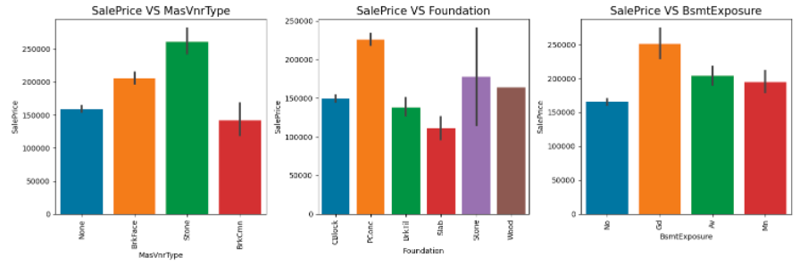
Key visualizations for bivariate analysis

Slide 37
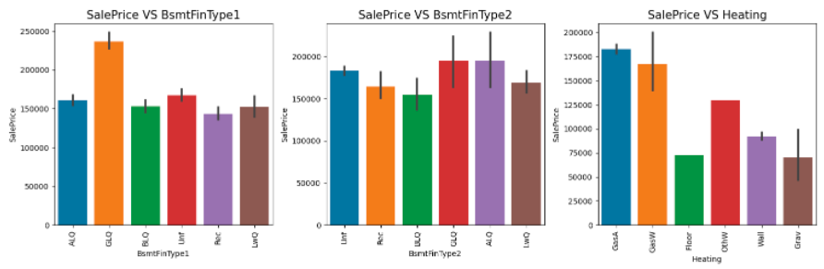
Key visualizations for bivariate analysis

Slide 38
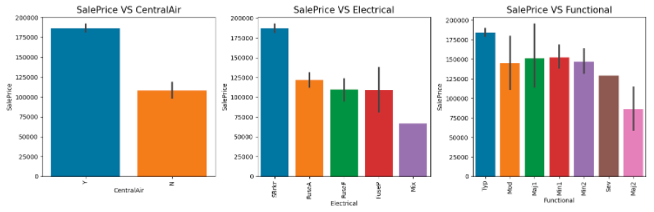
Key visualizations for bivariate analysis

Slide 39
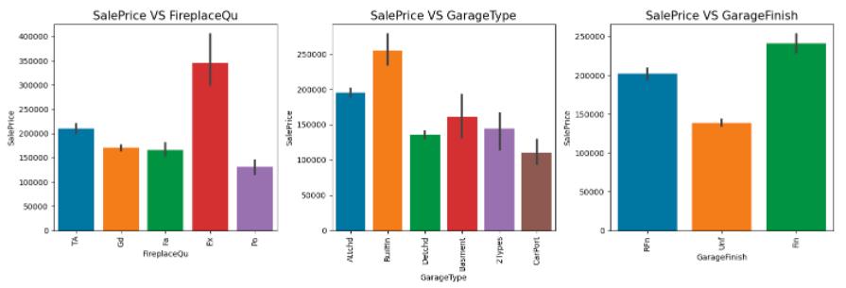
Key visualizations for bivariate analysis

Slide 40
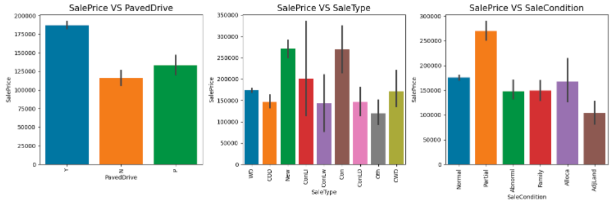
Key visualizations for bivariate analysis

Slide 41
Key visualizations for bivariate analysis
Observations
Homes with Stone masonry veneers have highest prices, followed by those with Brick Face. Houses with no masonry veneers and those with brick commons have similar sale prices.
Poured concrete foundation houses have higher sale prices, followed by houses having Stone foundations, which in some instances have been sold at prices almost as high as houses with poured concrete foundations. This is followed by houses with wood, cinder block, brick and tile, and slab foundations.
Properties with good exposure to walkout or garden level walls have the highest sale prices.
Homes with Good Living Quarters finishing rating for basements have the highest prices, followed by all other categories, which are at almost similar sale prices.
Sale prices are the highest for homes with Gas forced warm air furnace and Gas hot water or steam heat heating systems.
Centrally air-conditioned homes have higher sale prices as compared to those that do not.
In terms of electrical systems, homes with Standard Circuit Breakers & Romex have the highest sale prices, while those with mixed electrical systems are priced the lowest in comparison.
Sale prices are the highest for homes with typical functionality, followed by a variable pricing for other categories of home functionality.

Slide 42
Key visualizations for bivariate analysis
Observations
Sale prices are by far the highest for homes with excellent fireplace quality
Houses with built-in garages are priced the highest, followed by those with attached garages, and basement garages.
From the plot, it is clear as expected that homes with finished garages have the highest prices, followed by roughly finished and finally with unfinished garages.
Homes with a paved driveway have the highest sale prices, as expected, followed by those with partial pavements.
Properties sold with contracts with low interest have witnessed highest sale prices in on off instances, however, in general, homes sold with Contract 15% Down payment regular terms, and Homes just constructed and sold have the highest sale prices.
Homes that were not completed when last assessed (i.e., primarily new homes) saw the highest sale prices.

Slide 43
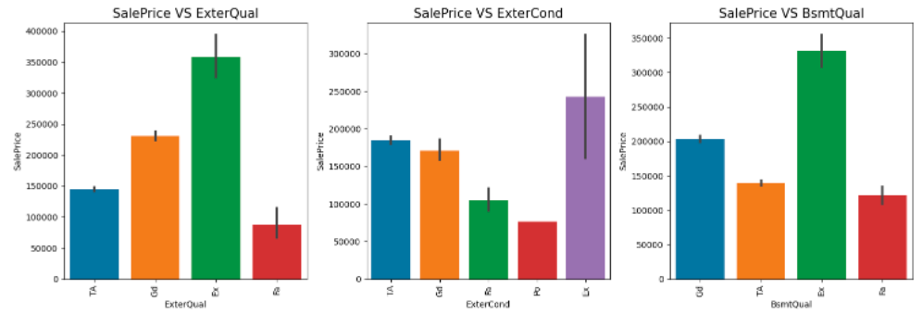
Key visualizations for bivariate analysis

Slide 44
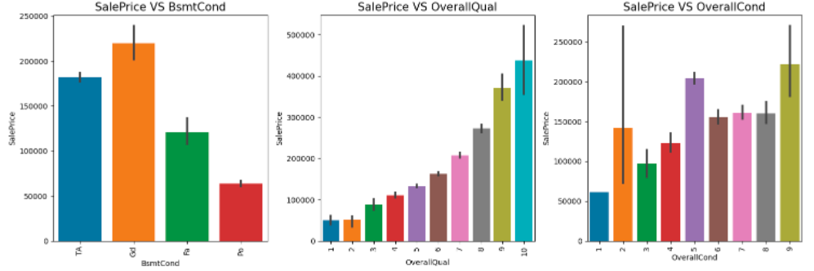
Key visualizations for bivariate analysis

Slide 45
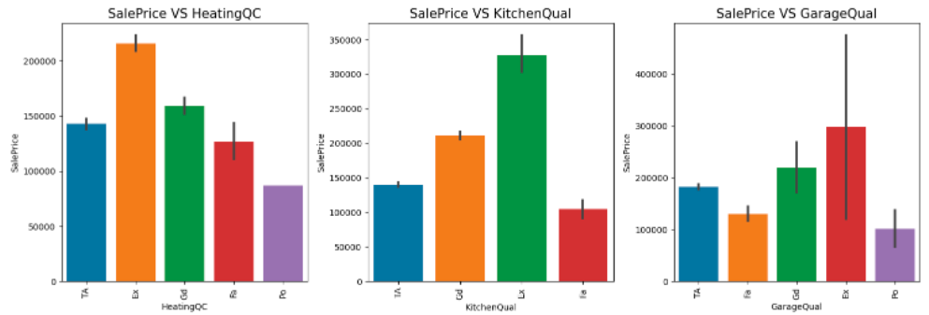
Key visualizations for bivariate analysis

Slide 46
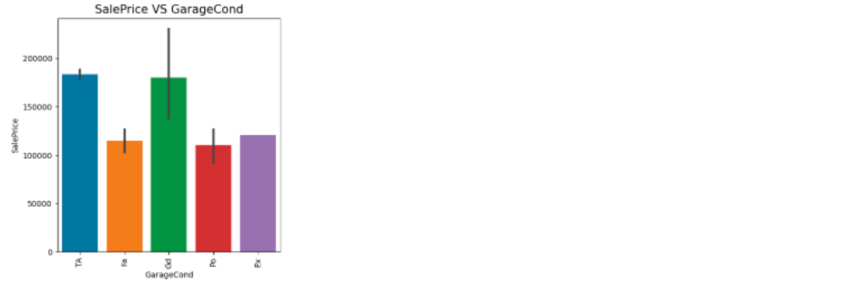
Key visualizations for bivariate analysis

Slide 47
Key visualizations for bivariate analysis
Observations
Sale pricing of houses increases with an increase in the exterior quality rating of the house, with excellent rated houses fetching the highest prices, followed by those rated as Good, Average and Poor.
Exterior condition of the house records a similar trend as in the case with exterior quality of the house.
In terms of basement quality, i.e., the height of the basement, those rated excellent (100+ inches) fetch highest sale prices in the housing market.
General condition of the basement is directly related to the sale price of the house, with houses having better condition basements fetching prices in the market.
Overall quality of the house experiences a linear relationship with the sale price of the house, with price increasing with each higher rating of the house.
Ratings on the overall condition of the house does not experience a linear relationship with the sale pricing of the house. The highest pricing going for those rated 9 (no data for houses rated 10), followed by those rated 5, and some instances of those rated 2, but 8,7, and 6 in general.
An excellent heating quality and condition rating fetches highest sale prices, followed by Good, typical, fair, and poor rated houses respectively.
Garage Condition rating of good sees highest sale prices in the market, followed by typical/average rated garages of houses, with Excellent, Fair and Poor rated ones experiencing similar pricing levels.

Slide 48
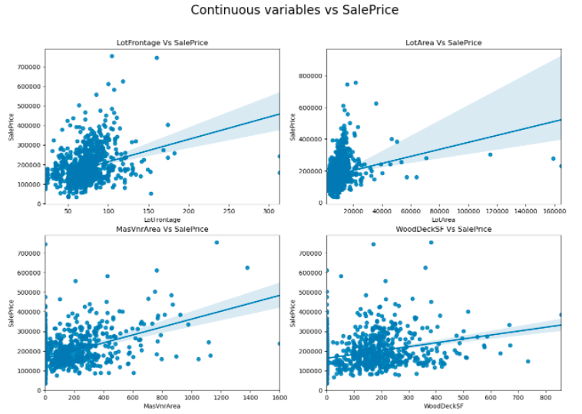
Key visualizations for bivariate analysis
We can see a weak and positive relationship between sale price and LotArea, MasVnrArea and WoodDeckSF respectively. Sale prices increase invariably as the aforementioned variables increase in values.

Slide 49
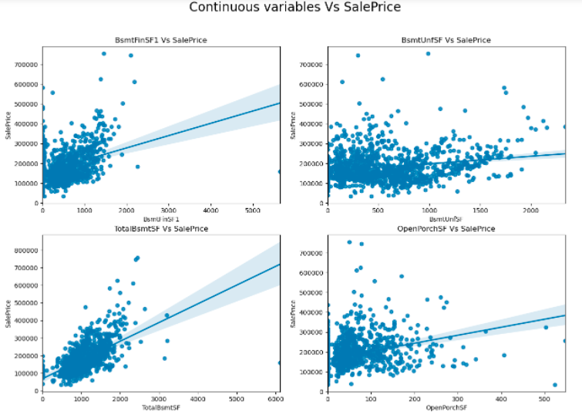
Key visualizations for bivariate analysis
There is a positive linear relationship between Sale Price and the variables. The sale price is high that is 100000-300000 when basement square feet lie up to 1500 square feet. When the unfinished basement area is below 1000 square feet, the sale price isn't as high.

Slide 50
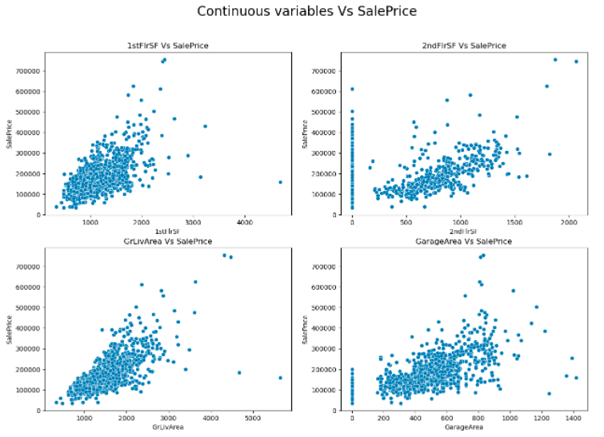
Key visualizations for bivariate analysis
As the values of the variables are increasing, there appears to be an increase in sale price of the houses/properties. The sale prices increase with the increase in the square footage of the 1st and 2nd floors, along with a similar trend with the above grade living area.

Slide 51
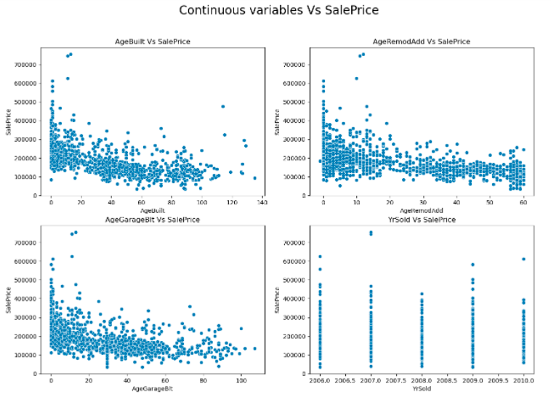
Key visualizations for bivariate analysis
Price appears to be declining as the age variables increase. Year in which a building/property is sold does not seem to have a significant impact on the sale price of the building/property.

Slide 52
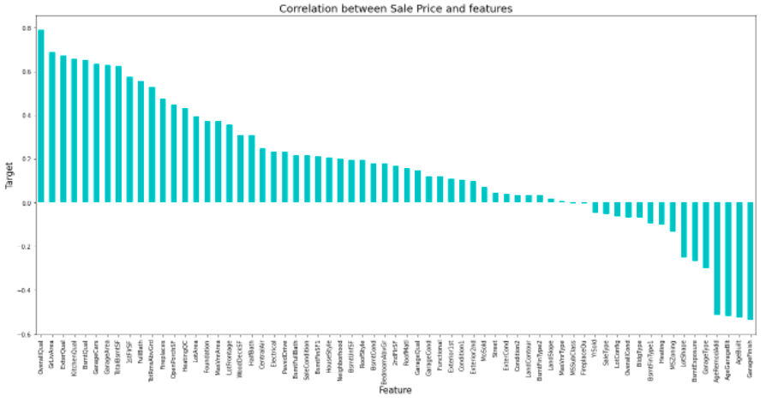
Key visualizations for establishing correlations

Slide 53
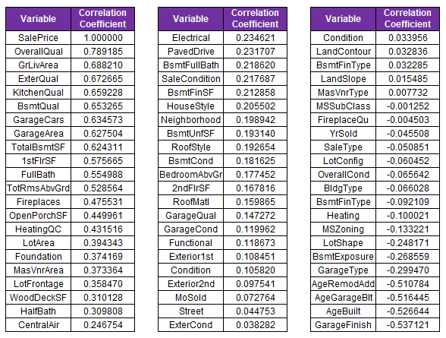
Key visualizations for establishing correlations
Features with high positive correlation with Sale Price
Features with high negative correlation with Sale Price
OverallQual
GrLivArea
ExterQual
KitchenQual
BsmtQual
GarageCars
GarageArea
TotalBsmtSF
1stFlrSF
FullBath
TotRmsAbvGrd
LotShape
BsmtExposure
GarageType
AgeRemodAdd
AgeGarageBlt
AgeBuilt
GarageFinish

Slide 54
Assumptions related to the problem
Columns dropped because of the presence of zeros or null values did not adversely impact the prediction accuracy from the machine learning model built using the dataset.
The imputing techniques used to handle missing or null values in the dataset did not adversely impact the correlations derived post imputing the record values.

Slide 55
Model building - journey
The categorical and numerical features were analyzed using appropriate bar and pie plots for conducting a thorough analysis of the features, and eventually understanding the importance of each attribute in relation to the target, as well as on its own. This helped to draw some unexpected insights, especially from attributes that provided a rating for certain factors affecting sale prices of houses.
Moreover, the statistical summary was obtained through the description function to gain some meaningful insights about the features in the dataset, including the presence of skewness, distribution of data, and outliers. The heatmap and bar plot help establish an understanding of the correlation of various features with each other, as well as with the target variable.
The training dataset was used to train the machine learning model for prediction of sale prices of houses, and the accuracy and cross validation scores were verified for four different algorithms – linear regression, random forest, support vector regression and decision tree. Based on the results, hyperparameter tuning was carried out for improving the accuracy of the prediction model, which was also plotted. The best model was used to predict the sale prices in the test dataset, post bringing the test dataset at the same level as the training dataset.

Slide 56
Model building – summary of steps undertaken
Once the training dataset was ready for building the prediction model, a 70:30 train test split was created. The best random state was also computed for the purpose of training the model on Random Forest Regression Algorithm and document an initial R2 accuracy score.
Four different algorithms (LR, RF, SVR and DT) were trained on the dataset, following which, their R2 scores, mean squared errors and cross validation scores were computed and documented. It was evident from the results that random forest regression would provide us with the best accuracy in predicting the sale prices of houses. Post the hyperparameter tuning, we had our best model for predicting the sale prices of houses.
The best prediction model from the steps undertaken was saved for predicting the housing prices on the training dataset.
Once the test dataset was evaluated and pre-processed and ready for prediction, the prediction model saved was reloaded and the predictions were processed and documented on the test dataset.

Slide 57
Model building – algorithms used
Linear Regression: It is one of the easiest and most popular Machine Learning algorithms. It is a statistical method that is used for predictive analysis. Linear regression makes predictions for continuous/real or numeric variables such as sales, salary, age, product price, etc.
Random Forest Regression: It is a supervised learning algorithm that uses ensemble learning method for regression. Ensemble learning method is a technique that combines predictions from multiple machine learning algorithms to make a more accurate prediction than a single model.
Support Vector Regression (SVR): It is a supervised learning algorithm that is used to predict discrete values. Support Vector Regression uses the same principle as the SVMs. The basic idea behind SVR is to find the best fit line. In SVR, the best fit line is the hyperplane that has the maximum number of points.
Decision Tree Regression: Decision tree regression observes features of an object and trains a model in the structure of a tree to predict data in the future to produce meaningful continuous output. Continuous output means that the output/result is not discrete, i.e., it is not represented just by a discrete, known set of numbers or values.

Slide 58
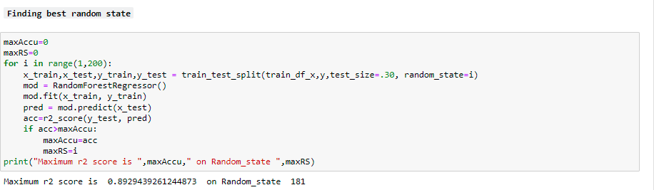
Model building – finding the best random state
Random_state is used to set the seed for the random generator so that we can ensure that the results that we get can be reproduced. Because of the nature of splitting the data in train and test is randomized you would get different data assigned to the train and test data unless you can control for the random factor.

Slide 59
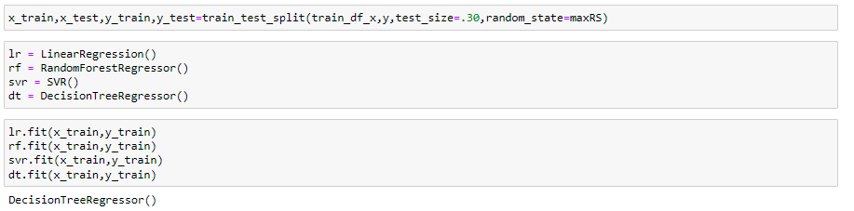
Model building – training the models

Slide 60
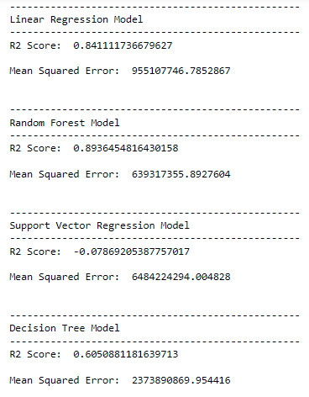
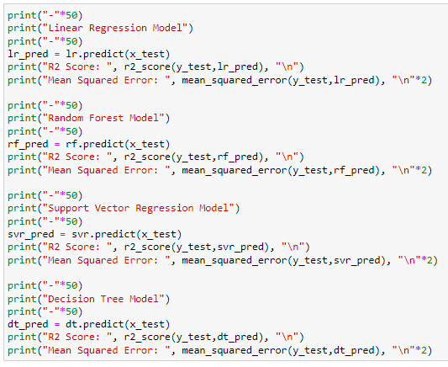
Model building – Computing R² score and MSE

Slide 61
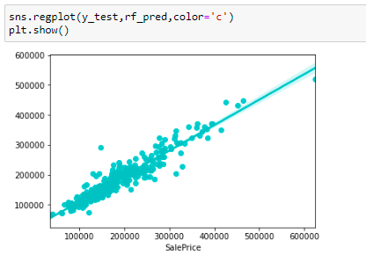
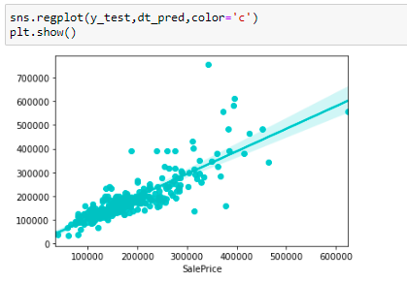
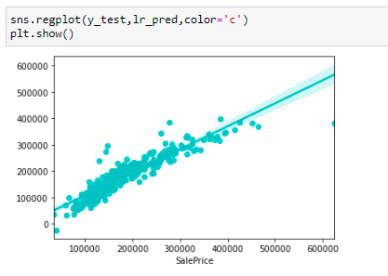
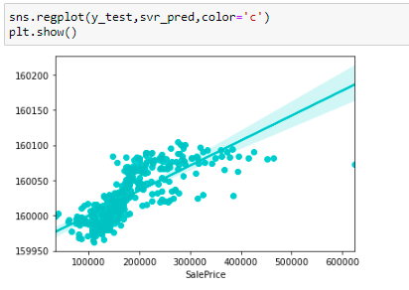
Model building – visualizing the results
Random Forest Regression
Decision Tree Regression
Linear Regression
Support Vector Regression

Slide 62
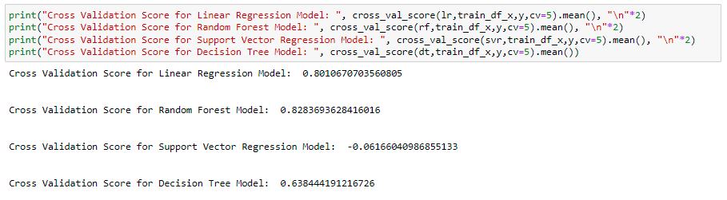
Model building – cross validation scores
Cross-validation is primarily used in applied machine learning to estimate the skill of a machine learning model on unseen data. That is, to use a limited sample in order to estimate how the model is expected to perform in general when used to make predictions on data not used during the training of the model

Slide 63
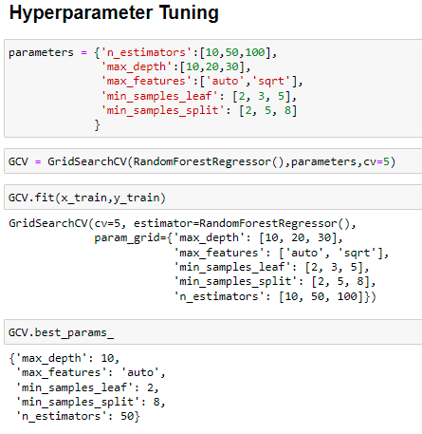
Model building – hyperparameter tuning
Hyperparameter tuning is an essential part of controlling the behavior of a machine learning model. If we don't correctly tune our hyperparameters, our estimated model parameters produce suboptimal results, as they don't minimize the loss function. This means our model makes more errors.

Slide 64
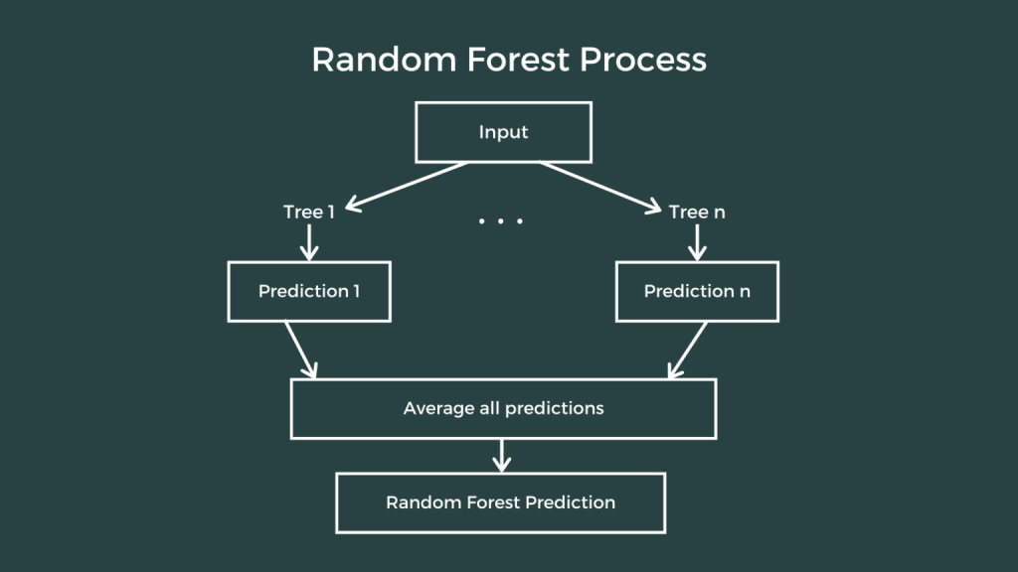
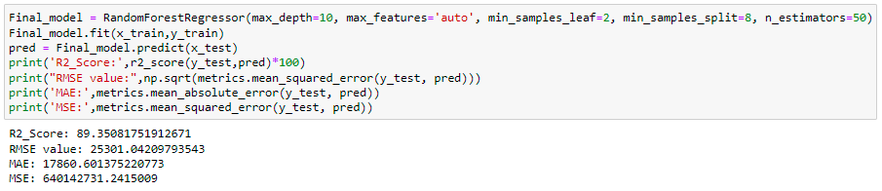
Model building – results of the best fit model

Slide 65
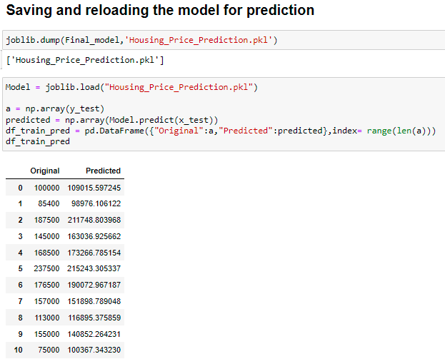
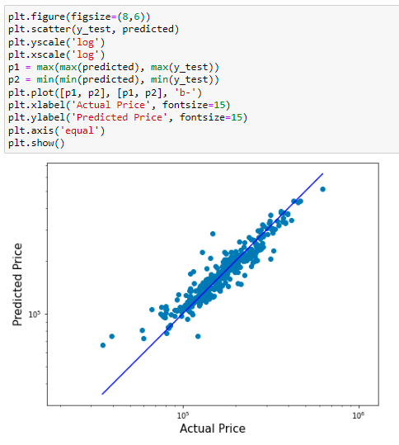
Model building – predictions from training dataset

Slide 66
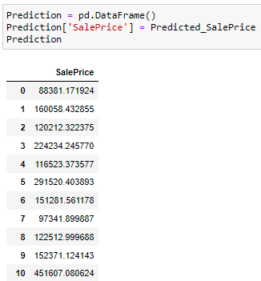
Model building – predictions on test dataset

Slide 67
Conclusions
In this study, we have used multiple machine learning models to predict the house sale price. We have gone through the data analysis by performing feature engineering and finding the relation between features and labels. And got the important feature and predicted the price by building ML models.
The house's structural features the structural attributes of the house, such as lot size, lot shape, quality and condition of the house, garage capacity, rooms, Lot frontage, number of bedrooms, bathrooms, overall finishing of the house, and so on, all have a significant impact on the house price. The characteristics of the neighborhood can be considered when determining the price of a home.
Various plots aided in visualizing the feature-label relationships, confirming the significance of structural and locational attributes in estimating Sale Prices. Because the Training dataset was so small, some of the outliers had to be kept for the models to be properly trained. Despite working on a small dataset, the Random Forest Regressor performed well due to its robustness to outliers and indifference to nonlinear features.

Slide 68
Conclusions
Which variables are important to predict the price of the house?
Overall quality is the most important and has the greatest positive impact. Furthermore, features such as GarageArea, LotArea, 1stFlrSF, TotalBsmtSF, and so on have a somewhat linear relationship with the price variable.
How do these variables describe the price of the house?
Houses with very high overall quality, such as material and finish, have a high sale price. Also, we can see from the plot that as the overall quality of the house improves, so does the sale price. That is, there is a strong linear relationship between the SalePrice and the OverallQual. As a result, if the seller constructs the house with these qualities in mind, the house's sale price will rise.
The SalePrice and 1stFlrSF have a linear relationship. As we can see, as the size of the first-floor increases, so does the price. As a result, people prefer to live in houses with only 1-2 floors, and the cost of the house rises as a result.
We've also seen a positive linear relationship between the SalePrice and the GarageArea. As the size of the garage increases, so does the sale price.
There is positive linear relation between sale price and TotalBsmtSF. As total basement area increases, sale price also increases.
We have built many ML models using features that have some relationship with the target and have seen an increase in the accuracy of the best model.

Slide 69
Some limitations
Demographic data (age, income, buyer regional preferences, and reason for purchasing a home) is critical for understanding the housing market. Interest rates have an impact on the price and demand for homes. Economic cycles influence real estate prices, as do government policies, regulations, and legalizations, which are all important factors that may influence house sales.
The availability of data on the such features would aid in the development of a predictive model that would more accurately understand the relationship between the features and the target variable, resulting in more accurate predictions.
One of the major specific prospects is to expand the estate database to include more cities, allowing users to explore more houses and make more informed decisions.
It is recommended that the organization use this model to get an idea of the actual price when buying a house in the area covered by the dataset. The model can also be used with datasets from different cities and areas if they contain the same features. It is advised to consider the features that were deemed most important in this study to better estimate the sale price of houses.

Slide 70


